Slide 1
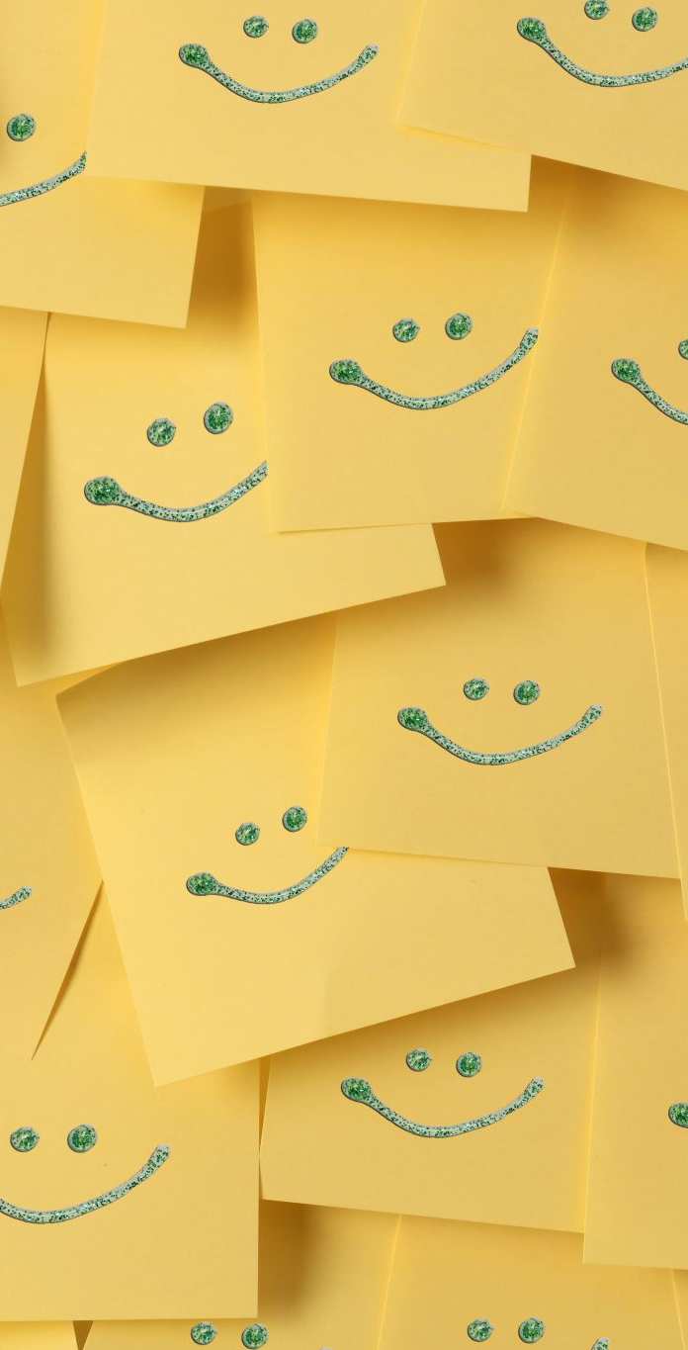
MS-606
EMOTIONS AND MOODS

Slide 2

Emotions at Work
Until recently, the field of OB has given emotions little attention
Myth of rationality: Emotions are thought to be the antithesis of rationality. Managers tried to create organizations that were emotion-free
Emotions are disruptive: Researchers looked at strong negative emotions that interfered with an employee’s ability to work effectively.

Slide 3
Definitions
Affect is a generic term that covers a broad range of feelings people experience, including both emotions and moods.
Emotions are intense feelings directed at someone or something.
Moods are less intense feelings than emotions and often arise without a specific event acting as a stimulus.

Slide 4
Difference between Emotions & Moods
EMOTIONS | MOODS
Emotions are more fleeting than moods. | When you’re in a bad mood, you can feel bad for several hours.
Emotions are reactions to a person or an event. | Moods are not directed at a person or an event.
Emotions can turn into moods when you lose focus on the event or object that started the feeling. | Good or bad moods can make you more emotional in response to an event.

Slide 5
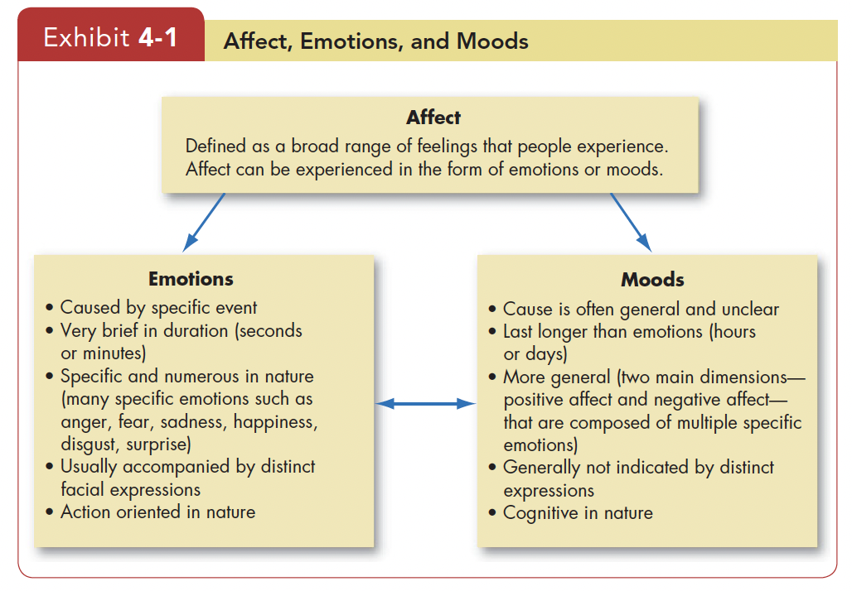

Slide 6
The Basic Emotions
Anger, contempt, enthusiasm, envy, fear, frustration, disappointment, embarrassment, disgust, happiness, hate, hope, jealousy, joy, love, pride, surprise, and sadness
Researchers have tried to limit them to a fundamental set
René Descartes, often called the founder of modern philosophy, identified six “simple and primitive passions”— wonder, love, hatred, desire, joy, and sadness
Psychologists have tried to identify basic emotions by studying facial expressions.
Cultures have norms that govern emotional expression
Researchers agree on six essentially universal emotions—happiness—surprise—fear—sadness—anger—disgust

Slide 7
The Basic Moods: Positive and Negative Affect
Positive emotions—such as joy and gratitude—express a favorable evaluation or feeling.
Negative emotions—such as anger or guilt
Being neutral is being nonemotional
When we group emotions into positive and negative categories, they become mood states
Positive affect A mood dimension that consists of specific positive emotions such as excitement, self-assurance, and cheerfulness at the high end and boredom, sluggishness, and tiredness at the low end.
Negative affect A mood dimension that consists of emotions such as nervousness, stress, and anxiety at the high end and relaxation, tranquility, and poise at the low end.

Slide 8
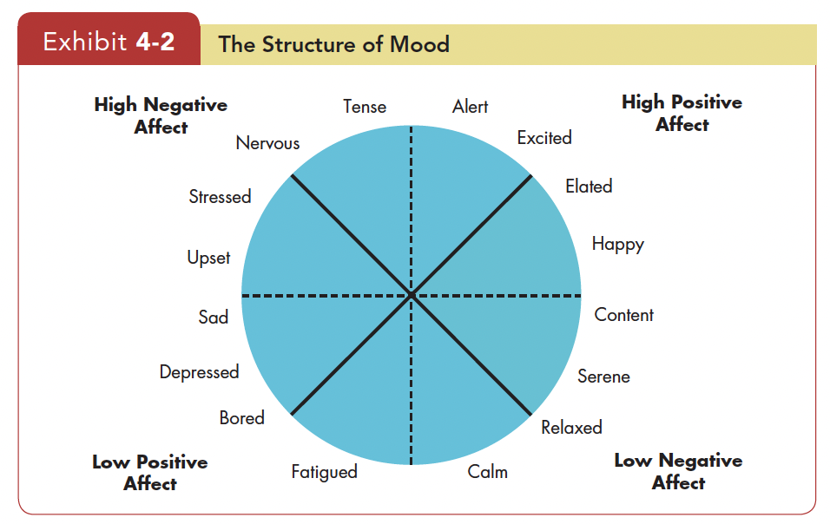

Slide 9

Moods
Negative emotions are likely to translate into negative moods.
People recall negative experiences more readily than positive ones.
Positivity offset: at zero input (when nothing in particular is going on), most individuals experience a mildly positive mood

Slide 10
Emotions & Cultures
In China, people report experiencing fewer positive and negative emotions
Taiwanese are more like U.S. workers, they report more positive and fewer negative emotions
People from all over the world interpret negative and positive emotions in the same way cultures value certain emotions more than others.
U.S. culture values enthusiasm, while the Chinese consider negative emotions more useful and constructive.
Pride is generally a positive emotion in Western cultures such as the United States, but Eastern cultures such as China and Japan view pride as undesirable.

Slide 11
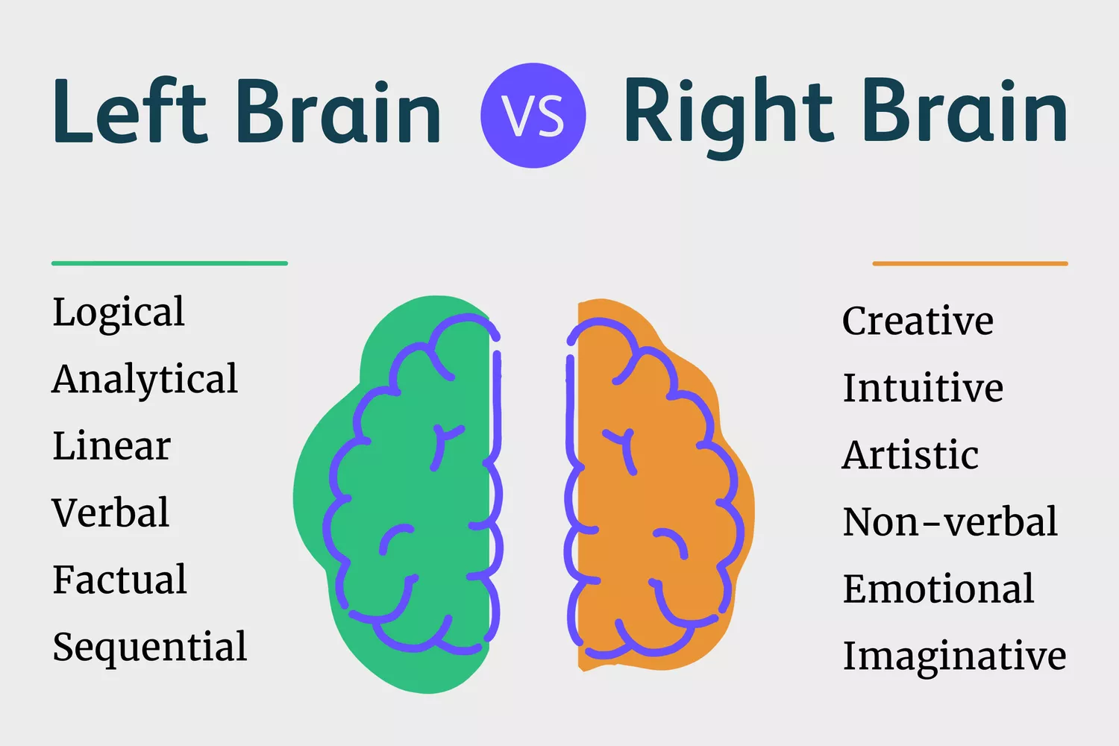
The Function of Emotions
Do Emotions Make Us Irrational?
Rationality and emotion are in conflict
Emotions are critical to rational thinking
Example, Phineas Gage
The key to good decision making is to employ both thinking and feeling in our decisions.

Slide 12
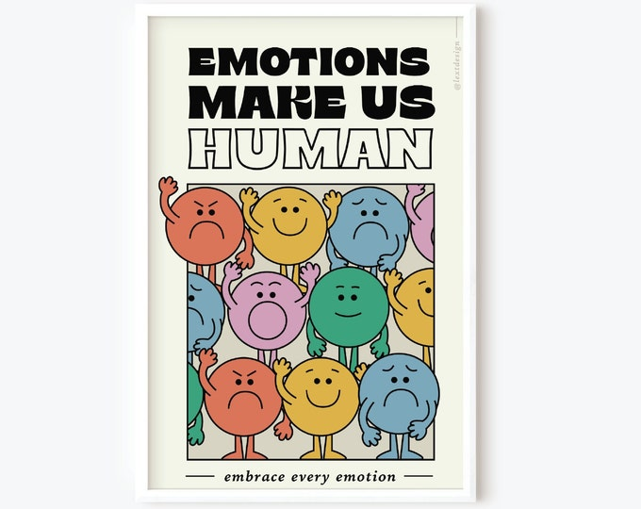
The Function of Emotions
Do Emotions Make Us Ethical?
Ethical decision making was based on cognition
Moral emotions include sympathy for the suffering of others, guilt about our own immoral behavior, anger about injustice done to others, contempt for those who behave unethically
These reactions are largely based on feelings rather than only cognition.

Slide 13
Sources of Emotions and Moods
Personality
  People differ in affect intensity, or how strongly they experience their emotions
Weather
  Illusory correlation occurs when people associate two events (nice weather and mood) that in reality have no connection.
Social Activities
  Activities that are physical, informal, or epicurean are more strongly associated with increases in positive mood than events that are formal or sedentary
Stress
Sleep
  Poor or reduced sleep impairs decision making and makes it difficult to control emotions
Exercise
  “sweat therapy”
Age
  Emotional experience improves with age
Gender
  Women’s reactions as being dispositional, whereas men’s reactions were interpreted as being due to the situation around them

Slide 14
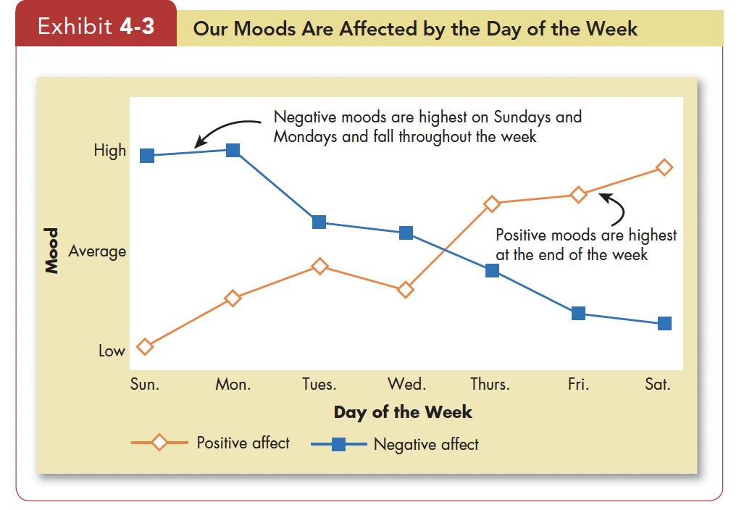

Slide 15
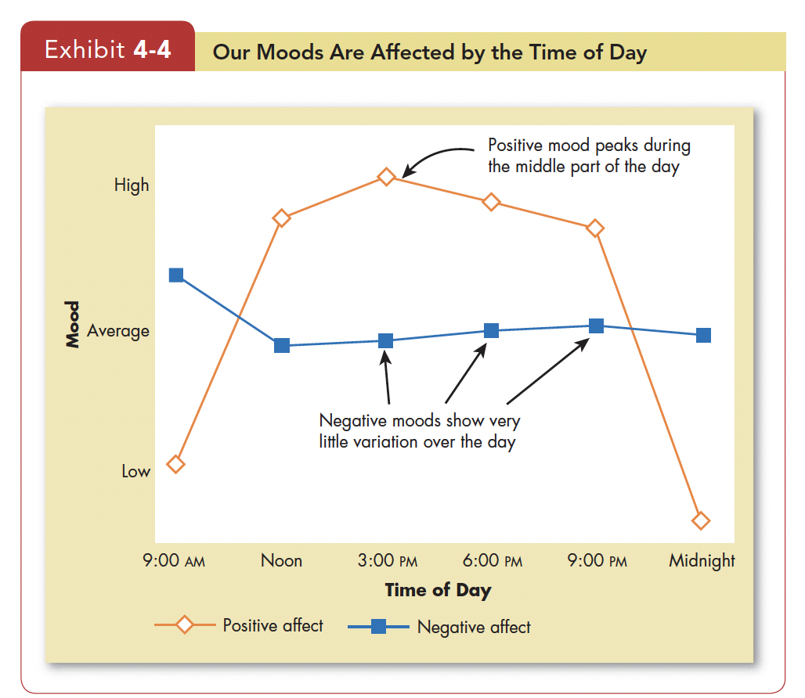

Slide 16
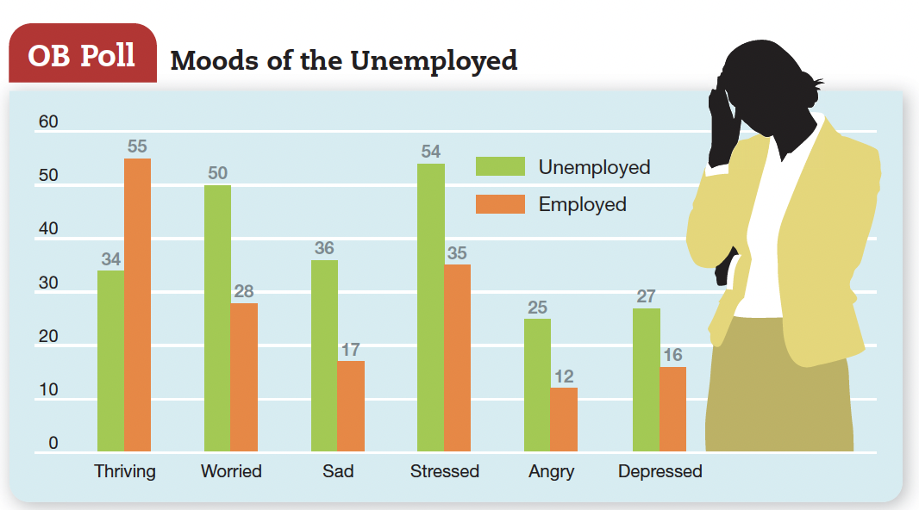

Slide 17
Emotional Labor ^{(1/2)}
In addition to physical and mental labor, jobs also require emotional labor.
Emotional labor A situation in which an employee expresses organizationally desired emotions during interpersonal transactions at work.
The concept of emotional labor emerged from studies of service jobs.
The challenge arises when employees have to project one emotion while feeling another. This disparity is emotional dissonance

Slide 18
Emotional Labor ^{(2/2)}
It is helpful if you separate emotions into felt or displayed emotions on the job.
Felt emotions are an individual’s actual emotions. In contrast, displayed emotions are those that the organization requires workers to show and considers appropriate in a given job.
Displaying fake emotions requires us to suppress real ones.
Surface acting is hiding inner feelings and forgoing emotional expressions in response to display rules. Deep acting is trying to modify our true inner feelings based on display rules.

Slide 19
Affective Events Theory
Affective events theory (AET) A model that suggests that workplace events cause emotional reactions on the part of employees, which then influence workplace attitudes and behaviors.

Slide 20
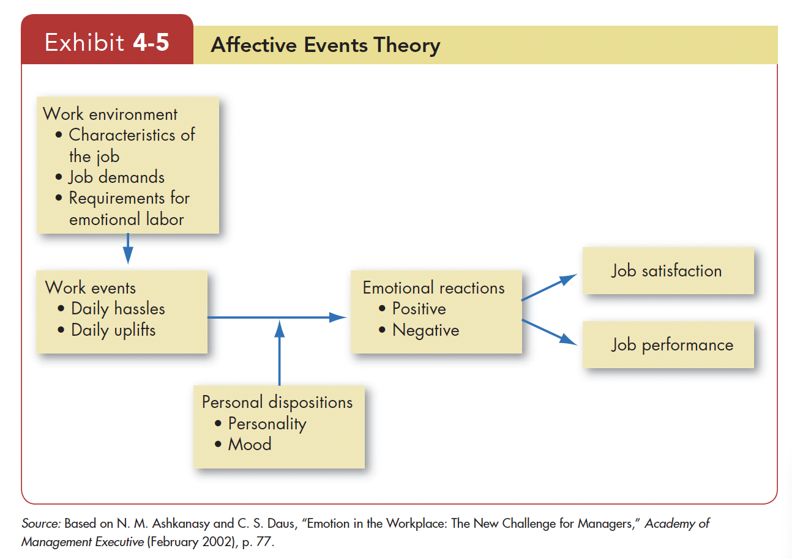

Slide 21
Emotional Intelligence
Emotional intelligence (EI) is a person’s ability to (1) perceive emotions in the self and others, (2) understand the meaning of these emotions, and (3) regulate one’s emotions accordingly

Slide 22
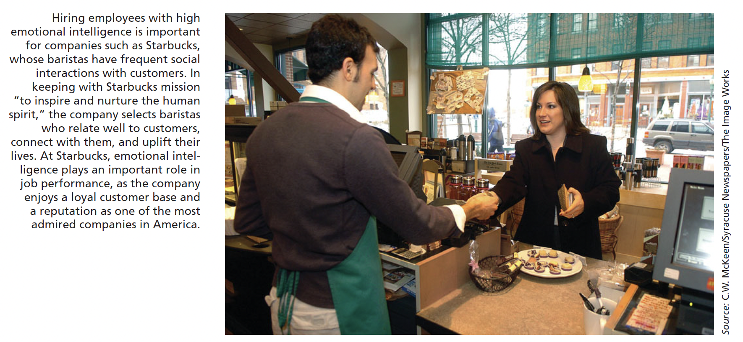

Slide 23
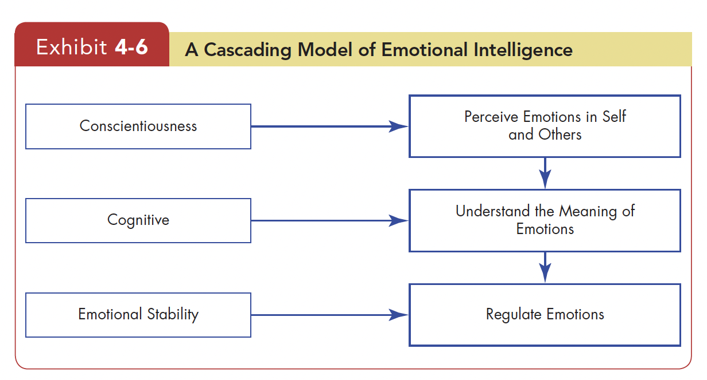

Slide 24
Emotion Regulation
Emotion regulation is to identify and modify the emotions you feel.
Strategies to change your emotions include
  thinking about more pleasant things
  suppressing negative thoughts
  distracting yourself
  reappraising the situation
  engaging in relaxation techniques

Slide 25
OB Applications of Emotions and Moods ^{(1/3)}
Selection: Employers should consider EI a factor in hiring employees, especially in jobs that demand a high degree of social interaction.
Decision Making: Moods and emotions have important effects. Positive emotions also enhance problem-solving skills, so positive people find better solutions to problems.
Creativity: People in good moods tend to be more creative and produce more ideas than people in bad moods

Slide 26
OB Applications of Emotions and Moods ^{(2/3)}
Motivation: Several studies have highlighted the importance of moods and emotions on motivation.
Leadership: Effective leaders rely on emotional appeals to help convey their messages.
Negotiation: It is an emotional process; a skilled negotiator has a “poker face.”

Slide 27
OB Applications of Emotions and Moods ^{(3/3)}
Customer Service: A worker’s emotional state influences customer service, which influences levels of repeat business and of customer satisfaction. Employees’ emotions can transfer to the customer. It is called emotional contagion —the “catching” of emotions from others
Deviant Workplace Behaviors: People often behave in ways that violate established norms and threaten the organization, its members, or both.
Safety and Injury at Work: Bad moods can contribute to injury at work

